Slide 1
COURSE REGISTRATION SYSTEM
SREEKANTH KUMAR VOBILISHETTY
AKHILA YARLAGADDA
PIYUSHA VARSHINI TIRUKOVALLURU
MEGHANA REDDY AKKATI

Slide 2
DESCRIPTION
Course registration system is a website where students from various departments in a university can register for courses of their choice online.
STUDENT
ADD
DROP
SWAP

Slide 3
DESCRIPTION
ADMIN
EDIT COURSES( PROFESSOR, TIMINGS, STRENGTH)
EDIT PAYMENTS

Slide 4
TECHNOLOGIES USED
Java Spring Boot
JavaScript
HTML
CSS
JSP

Slide 5
ENVIRONMENT
Spring Tool Suite 4-4.2.0
Visual Studio
GitHub

Slide 6
ROLES AND RESPONSIBILITIES
Sreekanth Kumar Vobilishetty- SYSTEM ARCHITECT
Akhila Yarlagadda – Team Lead
Piyusha Varshini Tirukovalluru- Development lead
Meghana Reddy Akkati- Quality Assurance and Test Lead

Slide 7
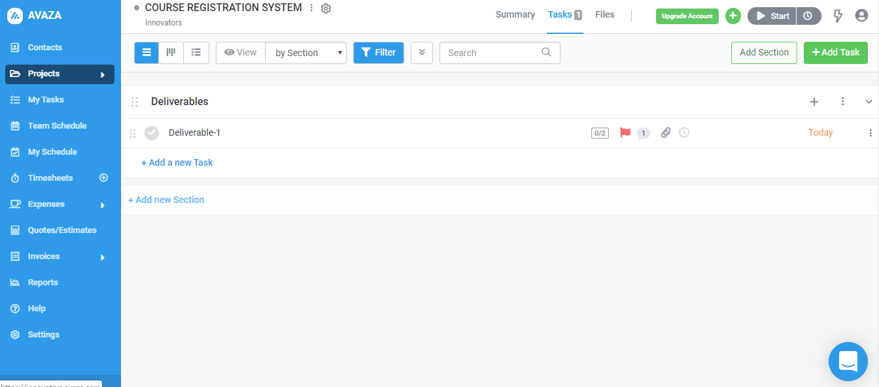
PROJECT MANAGEMENT TOOL

Slide 8

PROJECT SPECIFIC RISKS
1. Schedule Risk
Schedule risk includes wrong time estimation, last minute change in requirements and resource unavailability which leads to difficulty in integration.
All these risks lead to compromise in project deadline.
2. Password storage risk
If the admin password is compromised, there is a risk of whole website compromise and finance information leakage.
If the password list of all students is stored directly in database, they can be accessed easily which may lead to accounts hack.

Slide 9
PROJECT SPECIFIC RISKS
3. Ability to store and access curriculum information effectively
Due to the presence of large curriculum information, there is a high chance of ambiguity to store/access this information.

Slide 10
CONTINGENCY PLAN
Mitigation measures for risk 1:
First, accomplish the basic requirements of the system like system logic, exception handling, test cases etc. keeping track of the time availability.
Second, plan to integrate all parts of the code each time to confirm the compatibility.
Later, we decide on developing additional/optional features.

Slide 11
CONTINGENCY PLAN
Mitigation measure for risk 2:
Implementing password encryption mechanism while storing passwords in database.
Mitigation measure for risk 3:
Analyzing all the information including all the departments and courses and providing unique codes for each course which may lower this risk.

Slide 12
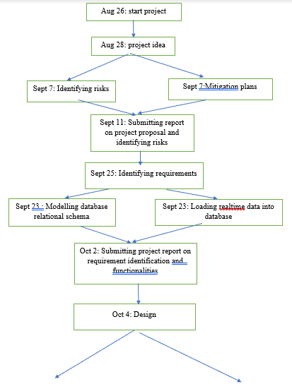
PERT chart

Slide 13
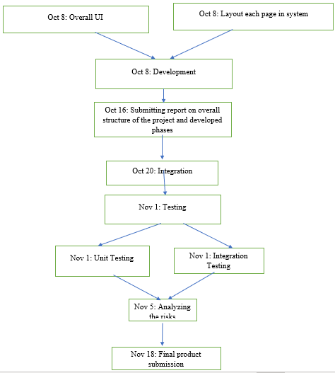
PERT chart

Slide 14
THANK YOU

